Slide 1
Introduction to Machine Learning
chunyang Wei 2013.10.17

Slide 2
Chunyang Wei
Recommendation Team
chunyang.wei@hulu.com

Slide 3
Introduction to Machine Learning
Lecture 1: Overview of Machine Learning & Linear regression
Lecture 2: Linear classification - Logistic Regression & SVM
Lecture 3: Non-linear classification – Decision Tree, Random Forest,
Neural Network, K-Nearest Neighbor
Lecture 4: Clustering – K-means, Mixture Gaussian
Lecture 5: Topic Model – PLSA, LDA
Lecture 6: Other topics - model combination & recall & other common model
Notes:
KNN??
NN??

Slide 4
Lecture 1: Overview of Machine Learning

Slide 5
Today’s Outline
Definition and Application of machine Learning
Categories of machine learning
A typical procedure of machine learning
Linear regression

Slide 6
Today’s Outline
Definition and Application of machine Learning
Categories of machine learning
A typical procedure of machine learning
Linear regression

Slide 7
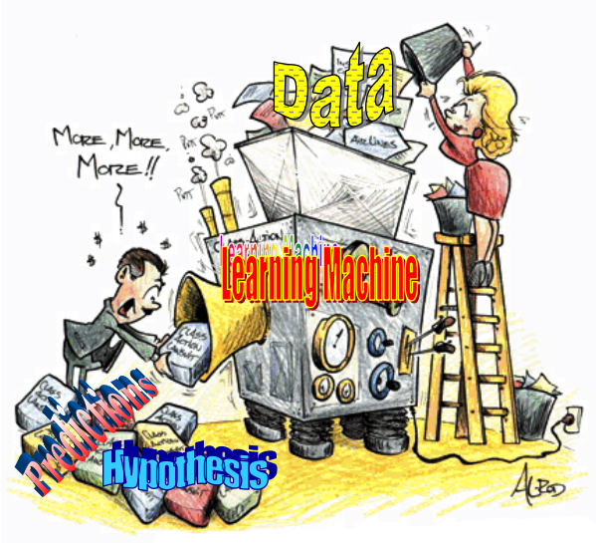
What is Machine Learning
Big Data
Data
Learning algorithm
Knowledge
Notes:
“Machine Learning is a field of study that gives computers the ability to learn without being explicitly programmed” - Arthur Samuel (1959)
Machine learning is a set of methods that can automatically detect patterns in data, and then use the uncovered patterns to predict future data, or to perform other kinds of decision making under uncertainty. – Machine Learning: A Probabilistic Perspective

Slide 8
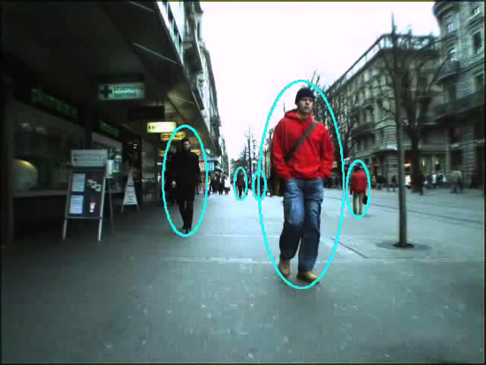

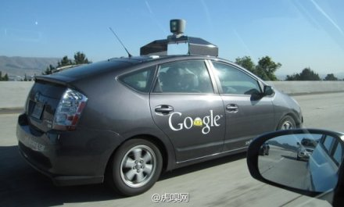




Application of Machine Learning
Notes:
Computer Vision, Speech Recognition, driverless car
NLP, ctr prediction, recommendation, search
医学领域、金融领域、问答系统
,

Slide 9
Today’s Outline
Definition and Application of machine Learning
Categories of machine learning
A typical procedure of machine learning
Linear regression

Slide 10
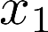
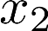
Categories of Learning problem
Machine Learning
Supervised Learning
Unsupervised Learning
Classification
Regression

Slide 11
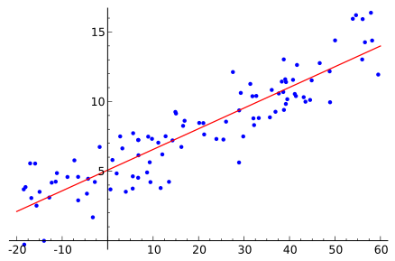
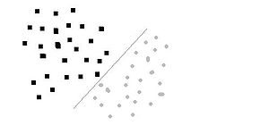
Supervised Learning
Learn a mapping from inputs to outputs , given a labled input-output pairs
Training set
Feature
Label
Regression problem
Classification problem
is continuous, real-valued, e.g. price, temperature
is categorical, .
e.g. gender
Notes:
D=\{(\mathbf{x}^{(i)},y^{(i)})\}~i=1…N
y^{(i)}\in\{1…C\}

Slide 12
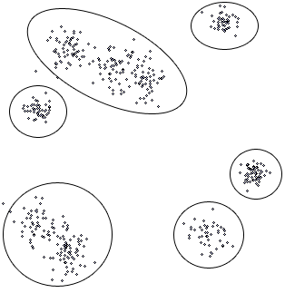
Unsupervised Learning
Give only inputs, , the goal is to find “interesting patterns” in the data
Goals
Clustering: discover groups of similar samples with the data
Density estimation: determine the distribution of data with the input space
Discovering latent factors: reduce the dimensionality by projection the data to a lower dimensional
Abnormal detection: detect abnormal sample in the input data set

Slide 13
Categories of Model
Linear / Non-linear
Linear: Predict function is a linear combination of the model parameters
Non-linear:
Discriminative / Generative
Discriminate: Learn conditional probability p(y|x) directly, or learn a direct mapping from input x to class label y
Generative: Learn joint probability p(x,y), and make their predictions by using Bayes rules to calculate p(x|y) and then picking the most likely label y
Parametric / Nonparametric
Parametric:
Nonparametric: Does not make any assumptions on the underlying data distribution
Notes:
编辑公式

Slide 14
Review our outline
Lecture 1: Overview of Machine Learning & Linear regression
Supervised Learning
Lecture 2: Linear classification - Logistic Regression & SVM
Lecture 3: Non-linear classification – Decision Tree, Random Forest,
Neural Network, K-nearest neighbor
Unsupervised Learning
Lecture 4: Clustering – K-means, Mixture Gaussian
Lecture 5: Topic Model – PLSA, LDA
Lecture 6: Other topics - model combination & recall & other common model
Notes:
KNN??
NN??

Slide 15
Today’s Outline
Definition and Application of machine Learning
Categories of machine learning
A typical procedure of machine learning
Linear regression

Slide 16
A typical procedure of machine learning
Train:
Figure out the problem
Generate dataset
(Determine the label and figure out features )
Train
(Build a model)
Refine the model
Feature selection
Try different models
Model
Test
Predict:
new data
Model
Output value

Slide 17
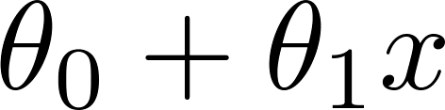
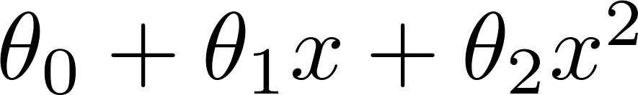
Overfitting problem
If the model is too much complex(have too many parameters), the learned prediction may fit the training set very well, but fail to generalize to new examples
Example: Predict price of the house according to size
Price
Price
Price
Size
Size
Size
Notes:
最左和最右，他们的generalization error都非常大，即在新的数据集上都不能有很好的表现，但是他们是因为不同的原因。

Slide 18
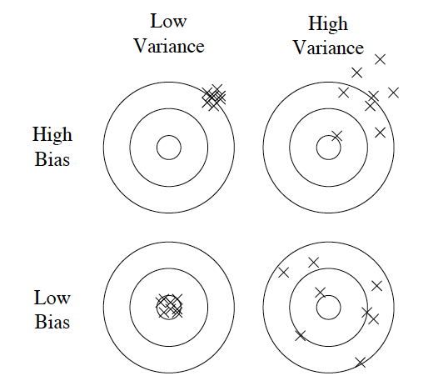
Bias & Variance
Bias: The average error of the model
Variance: The variability of the model
Simple model:
High bias, low variance
→Underfitting
Complex model:
Low bias, high variance
→Overfitting
Generalization error = Bias² + Variance + Noise
Notes:
假设有用同样方式生成的训练集很多个，我们训练出很多个model。
Bias指的是这些模型的平均error，
Variance指的是这些模型的变动性，即他们对同一个测试数据点预测的结果的变动性
简单模型，比如线性模型，通常来说，high bias, low variance。有时候模型可能没有得到充分的训练，这个称为underfitting
复杂模型，比如非线性模型，它可以把模型做的非常细，甚至可以在训练数据上达到百分之百的正确率，但是他的variance非常高。训练数据稍微改变一点，可能得到完全不一样的一个模型
模型的generalization error可以表示为：。。。
所以我们需要在Bias和variance之间做一个tradeoff，模型不能过于简单，也不能过于复杂，导致扩展性能同样不好

Slide 19
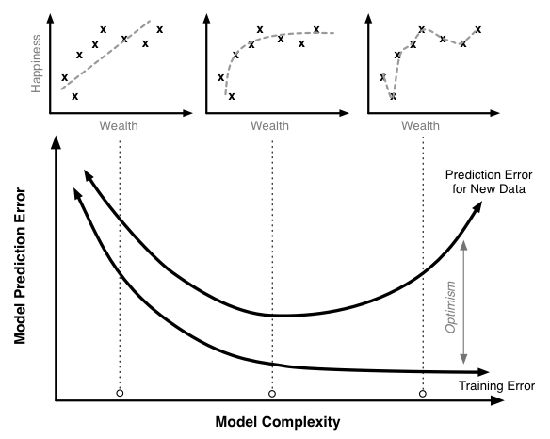
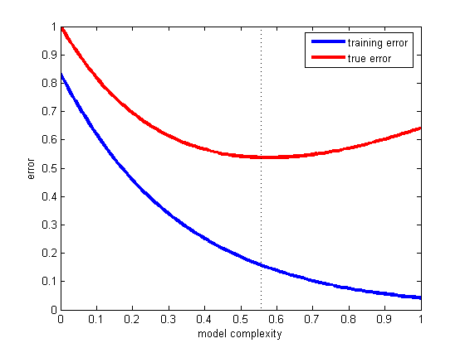
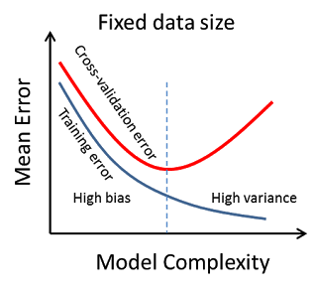
Training error & Testing error
We need to separate training set and testing set
Notes:
前半段，high bias,后半段high variance

Slide 20
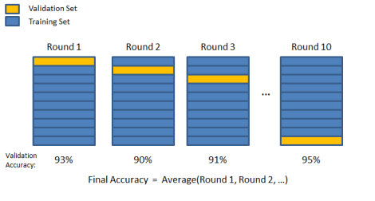
K-fold Cross validation
Random split training dataset into k subsets. S₁, S₂, …, S_{k}
For j = 1…k
Train the model on S-S_{j}
Test the model on S_{j}
Use avg(error(S_{j})) as the final metric
Pick the best model and retrain on the whole data set.

Slide 21
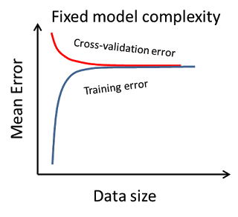
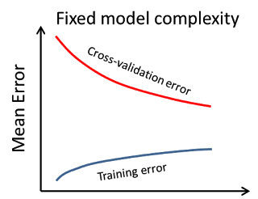
Overcome overfitting
Reduce dimension
Reduce feature to decrease the model complexity
Regularization
Restrict parameter space to control model complexity
Enlarge the training set
When high bias
When high variance
Notes:
Insert a picture

Slide 22
Today’s Outline
Definition and Application of machine Learning
Categories of machine learning
A typical procedure of machine learning
Linear regression

Slide 23
A simple Example
Supervised, Regression

Slide 24
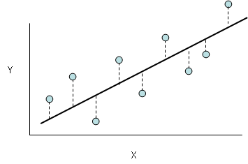
Build the model
Least mean squares:
Goal:
Hypothesis
Strategy
Optimization algorithm
Model
Strategy
Optimization
algorithm
Hypothesis
Gradient Descent
Notes:
y&=f(\mathbf{x}) \\
&=\mathbf{\theta^T }\mathbf{x} \\
&=\sum_{i=1}^{D}\theta_ix_i+\theta_0
J(\theta)=\frac{1}{2}\sum_{i=1}^{N}(f(\mathbf{x}^{(i)})-y^{(i)})^2
\arg\min_\theta{J(\theta)}

Slide 25
Cost function
Least Mean Squares
Another view of LMS
Assume
is the random noise, and they are distributed IID (independently and identically distributed)
maximum likelihood
Notes:
频率学派的观点: \theta不是随机变量，而是一个确定的值，只是不知道它是多少。
(y|x;\theta)表示给定了\theta后，如果x是某个值，那么y等于某个值的概率是多少呢，就是参数的似然性，我们可以把它看做是\theta的一个函数。
我们现在要做的就是找到一个\theta，使得这个似然性最大，也就是最大似然的思路
y^{(i)}=\theta^T x^{(i)} + \varepsilon^{(i)}
\varepsilon^{(i)} \sim \mathcal{N}(0,\sigma^2)
p(\varepsilon^{(i)})=\frac{1}{\sqrt{2\pi}\sigma}e^{-\frac{(\varepsilon^{(i)})^2}{2\sigma^2}}
p(y^{(i)}|x^{(i)};\theta)=\frac{1}{\sqrt{2\pi}\sigma}e^{-\frac{(y^{(i)}-\theta^Tx^{(i)})^2}{2\sigma^2}}
L(\theta)=p(\overrightarrow{y}|X;\theta)=\prod_i^m{p(y^{(i)}|x^{(i)};\theta)}=\prod_i^m{\frac{1}{\sqrt{2\pi}\sigma}e^{-\frac{(y^{(i)}-\theta^Tx^{(i)})^2}{2\sigma^2}}}
log(L(\theta))&=\sum_i^m{log{\frac{1}{\sqrt{2\pi}\sigma}e^{-\frac{(y^{(i)}-\theta^Tx^{(i)})^2}{2\sigma^2}}
}}\\
&=m log{\frac{1}{\sqrt{2\pi}\sigma}}-\frac{1}{\sigma^2}\frac{1}{2}\sum_i^m{(y^{(i)}-\theta^Tx^{(i)})^2}
max{L(\theta)} \Rightarrow min{\frac{1}{2}\sum_i^m{(y^{(i)}-\theta^Tx^{(i)})^2}}

Slide 26

Gradient Descend
Goal:
Main idea
Start with some
Keep changing to reduce until we hopefully end up at a minimum
J(θ₀,θ₁)
θ₁
θ₀

Slide 27
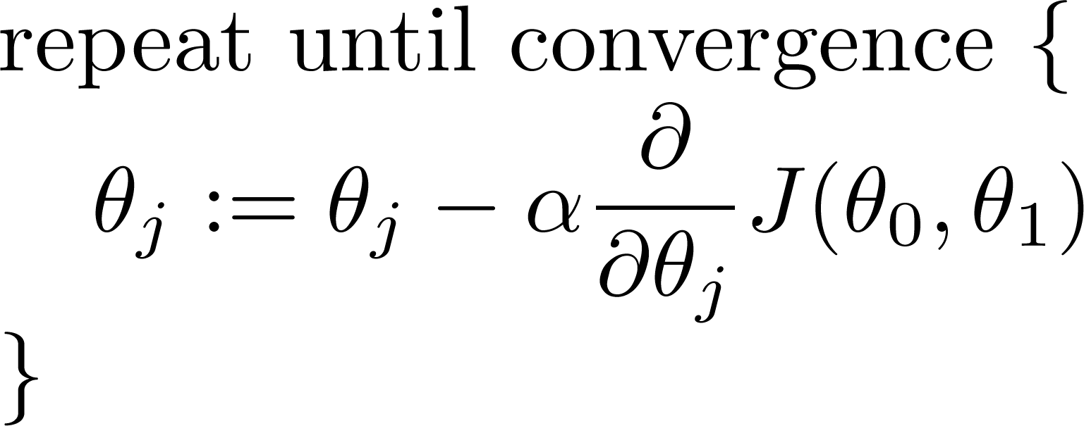
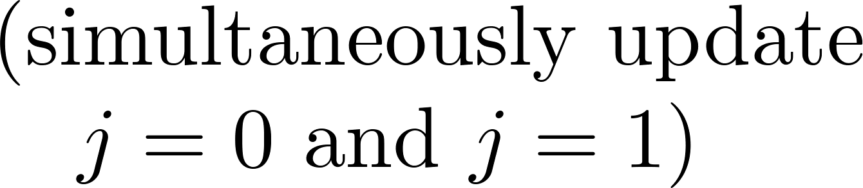
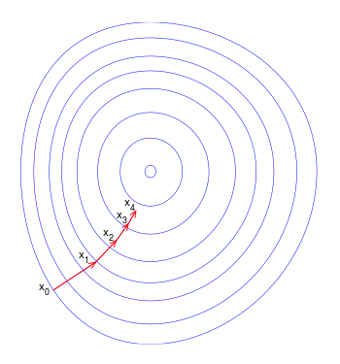
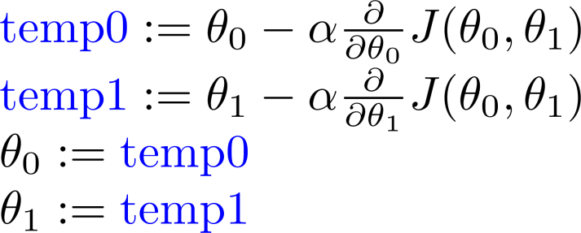
Gradient Descend Algorithm
learning rate
derivative
Simultaneously update:
Notes:
画图（抛物线）示意梯度下降过程，以及α太大太小的示例

Slide 28
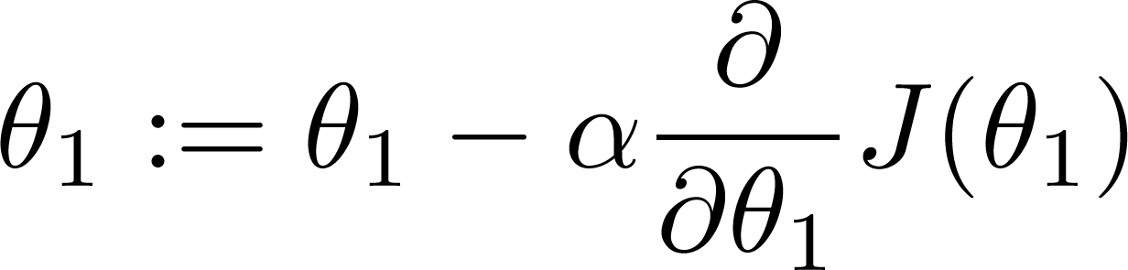
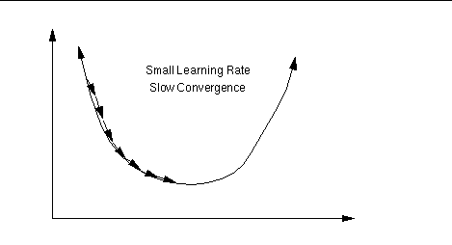
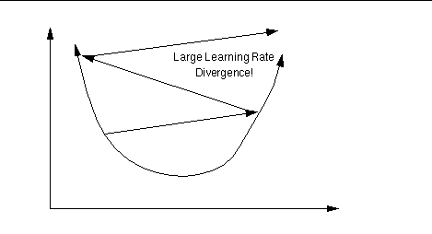
About Learning Rate
If is too small, gradient descent can be slow.
If is too large, gradient descent can overshoot the minimum. It may fail to converge, or even diverge.

Slide 29
local optima Issue
J(θ₀,θ₁)
θ₁
θ₀

Slide 30
local optima Issue
J(θ₀,θ₁)
θ₁
θ₀

Slide 31
Linear Regression Inference
Intuition:
Update according to the error
is a convex function, so it don’t suffer the local minimum problem
Notes:
&\frac{\partial J(\theta)}{\partial \theta_j}\\
&=\frac{\partial }{\partial \theta_j} \frac{1}{2}(f_{\theta}(\mathbf{x})-y)^2\\
&=(f_{\theta}(\mathbf{x})-y)\frac{\partial}{\partial\theta_j}(f_{\theta}(\mathbf{x})-y) \\
&=(f_{\theta}(\mathbf{x})-y)\frac{\partial}{\partial\theta_j}(\sum_{i=0}^d{\theta_i{x_i}}-y) \\
&=(f_{\theta}(\mathbf{x})-y)x_j

Slide 32
Batch vs. Stochastic
Batch gradient descent
- use all the data in one iteration
Stochastic gradient descent
- use one sample per iteration
Can convergent to global optima
Slowly for each iteration, especially when N is large
Convergent faster
May not reach the global optima
In practice, always use SGD, and decrease α gradually
Notes:
&Repeat~until~convergence~ \{\\
&~~~~~~~~\theta_j:= \theta_j + \alpha \sum_{i=1}^N{(y^{(i)}-f_\theta(x^{(i)})x_j^{(i)}} \\
&\}
&Repeat~until~convergence~ \{\\
&\qquad for~i=1…N ~\{ \\
&\qquad\qquad \theta_j:= \theta_j + \alpha (y^{(i)}-f_\theta(x^{(i)})x_j^{(i)} \\
&\qquad \} \\
&\}

Slide 33
Learning Material

Slide 34
Learning Material
Book
Pattern Recognition and Machine Learning
The elements of statistical learning
Machine Learning: A probabilistic perspective
统计学习方法 – 李航
Online course
Andrew Ng, coursera，网易公开课
Erix Xing, http://www.cs.cmu.edu/~epxing/Class/10701/lecture.html
龙星计划2012 – 余凯，张潼

Slide 35
Q & A
Thanks ！

